Slide 1
Density Based Clustering

Slide 2
DBSCAN
DBSCAN is a density-based algorithm.
DBSCAN requires two parameters: epsilon (Eps) and minimum points (MinPts).
It starts with an arbitrary starting point that has not been visited .
It then finds all the neighbour points within distance Eps of the starting point.
If the number of neighbours is greater than or equal to MinPts, a cluster is formed.
The starting point and its neighbours are added to this cluster and the starting point is marked as visited.
The algorithm then repeats the evaluation process for all the neighbours recursively.

Slide 3
DBSCAN
If the number of neighbours is less than MinPts, the point is marked as noise.
If a cluster is fully expanded (all points within reach are visited) then the algorithm proceeds to iterate through the remaining unvisited points in the dataset.

Slide 4
Major features:
Discover clusters of arbitrary shape
Handle noise
One scan
Need density parameters

Slide 5
Basic concept:
For any cluster we have:
A central point (p) i.e. core point
A distance from the core point(Eps)
Minimum number of points within the specified distance (MinPts)

Slide 6
DBSCAN Algorithm
Create a graph whose nodes are the points to be clustered
For each core-point c create an edge from c to every point p in the -neighborhood of c
Set N to the nodes of the graph;
If N does not contain any core points terminate
Pick a core point c in N
Let X be the set of nodes that can be reached from c by going forward;
a. create a cluster containing X∪∪{c}
b. N=N/(X ∪∪ {c})
Continue with step 4

Slide 7
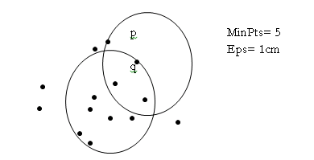
DBSCAN Algorithm

Slide 8
Density-Based Clustering Methods
Clustering based on density (local cluster criterion), such as density-connected points or based on an explicitly constructed density function
Major features:
Discover clusters of arbitrary shape
Handle noise
One scan
Need density parameters
Several interesting studies:
DBSCAN: Ester, et al. (KDD’96)
DENCLUE: Hinneburg & D. Keim (KDD’98/2006)
OPTICS: Ankerst, et al (SIGMOD’99).
CLIQUE: Agrawal, et al. (SIGMOD’98)

Slide 9
Density-Based Clustering Methods
DBSCAN is a density-based algorithm.
Density = number of points within a specified radius r (Eps)
A point is a core point if it has more than a specified number of points (MinPts) within Eps
These are points that are at the interior of a cluster
A border point has fewer than MinPts within Eps, but is in the neighborhood of a core point
A noise point is any point that is not a core point or a border point.

Slide 10
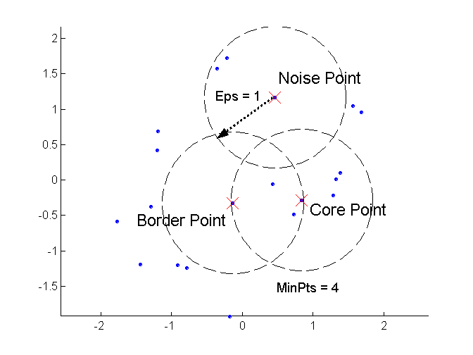
DBSCAN: Core, Border, and Noise Points

